Slide 2
1. Objective
To discuss the change management framework encompassing the effective qualitative and quantitative problem solving tools for equipping change agents within the sugar manufacturing organizations for establishing a long term continuous improvement culture within the company.

Slide 3
THINK: Why Do Organizations Exist?
Why Do Organizations Exist?
To provide Value
Best Quality P/S
Minimum Time
Competitive Cost

Slide 4
Value Deliverance IPO Model
An Input-Process-Output (IPO) diagram, also known as a general process diagram, provides a visual representation of a process by defining a process and demonstrating the relationships between input and output elements.
Y=f(x)
INPUTS
Measureable Outcome
OUTPUTS
People
“A blending of inputs to achieve the desired outputs”
Perform a Service
Material
PROCESS
Equipment
?
Policies
Produce a Product
Procedures
Methods
Environment
Complete a Task

Slide 5
Contd. .
Quality Objectives
OUTPUT
OUTCOME
PRODUCTION DEPARTMENT | Number of items Produced Types of Product Produced | % Defectives / Rejected Cost of Production/item Number of items/unit time
TESTING DEPARTMENT | Number of tests Types of Tests | Measurement Error % Delays of tests Cost of unit test
HRD | Number of persons hired Number of Trainings | Core Competence Duration of vacant posts % of Poor Hiring

Slide 6
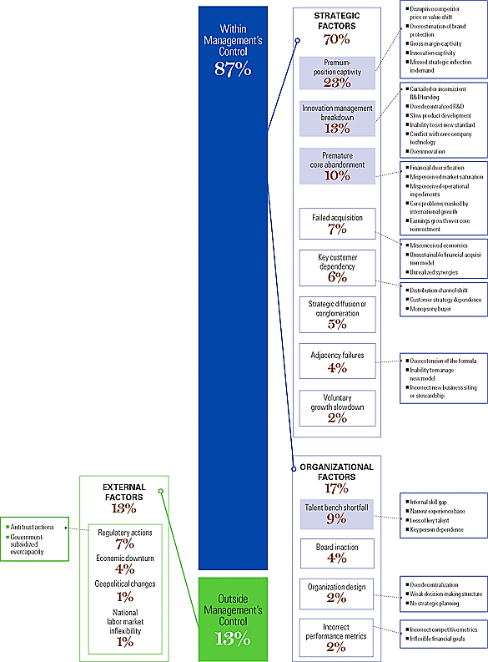
1930
Notes:
“The Root Causes of Revenue Stalls”

Slide 7
Organizational-Wide Deployment of Problem Solving Framework in Sugar Industry

Slide 8
Essence of Top to bottom deployment

Slide 9
2. Kotter Model – OWD Framework
1. Establishing a Sense of Urgency
2. Form powerful coalition
Creating the environment for change
3. Create Vision for Change
Engage & enable the organization
4. Communicate Vision
5.Empower Action
6. Generating Short-Term Wins
7. SUSTAIN ACCELERATION
Implement and sustain the change
8. INSTITUTE CHANGE

Slide 10
Contd. .
1. Establishing a Sense of Urgency
2. Form powerful coalition
3. Create Vision for Change
Having a vision is thus as same as having a destination, while the related plans are as same as using a compass to reach that destination.
Revenue Reports
Competitors Analysis
Changing Market Trends
Identification of right people within the right departments
Where do you want to see your organization after 5,10, 20 years?
Will you keep providing the same output or revise your portfolio?

Slide 11
Contd. .
4. Communicate Vision
When a man does not know what harbor he is making for, no wind is the right wind

Slide 12
Contd. .
5.Empower Action
Identification and selection of right team members
(TNA for Change Agents)
Understanding the current baseline understanding of the data, quality and productivity.
Development of Training BOK with stakeholders collaboration
Deliverance of the training wrt qualitative and quantitative problem solving tools along DMAIC Methodology overview
Qualification and execution of potential improvement opportunities

Slide 13
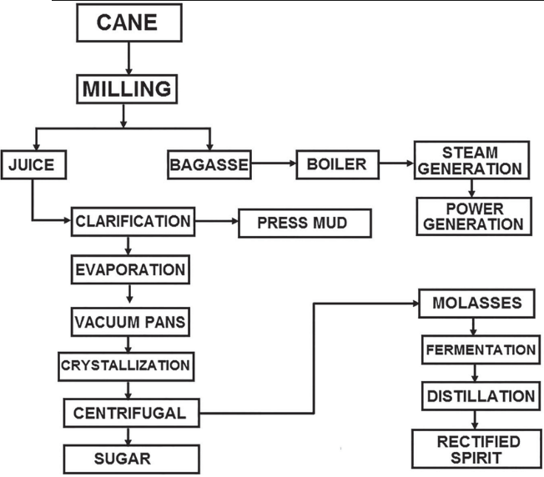
Contd. .
5.Empower Action
Analyzing the value chain to
understand the existing facts
Data
Quantitative Data
Qualitative Data
Define problem after
collecting numerical data
Define problem before
collecting numerical data
Basic and advanced Tools
The Seven New QC Tools
Analytical approach
7 QC Tools
QFD
Regression Analysis
MSA
Design of Experiments
They helped in generating
ideas and formulating plans
Affinity Diagram
PDCP Chart
Arrow Diagram
Prioritization Matrix
Tree Diagram
Organize to understand info
“Without data, you're just another person with an opinion.”
W. Edwards Deming
Factual decision making with
DMAIC Methodology

Slide 14
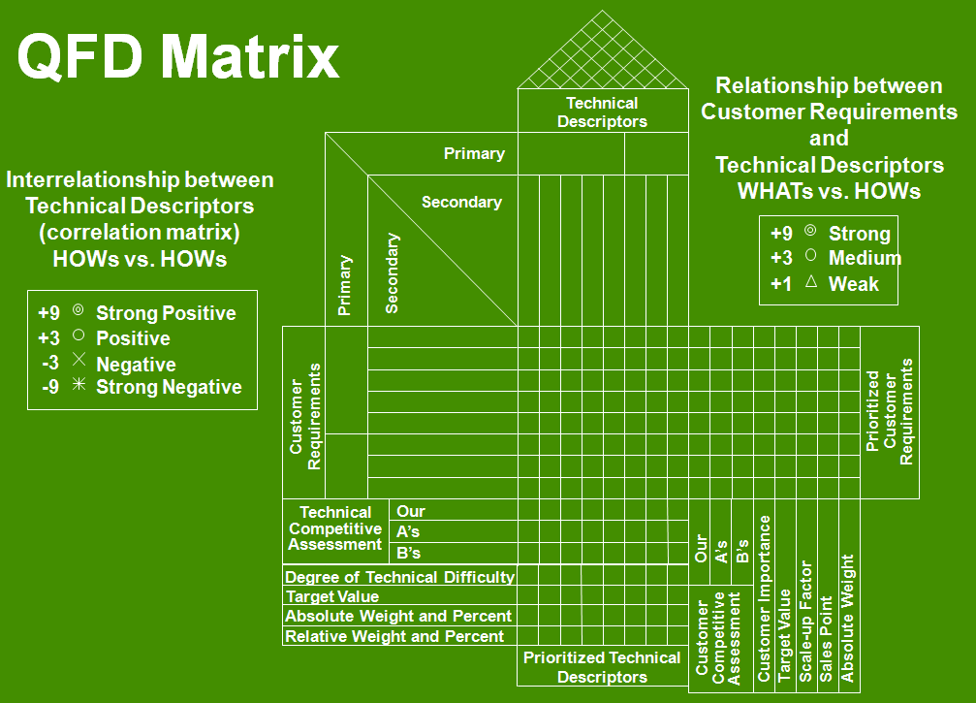
Examples: Quantitative Tool 1
Tool 1: QFD
“Quality Function Deployment (QFD) is a methodology for building the "Voice of the Customer" into product and service design.
Identify the Customer Requirements (WHATs)
Identify the Technical Requirements (HOWs)
Develop a Relationship Matrix Between WHATs & HOWs
Develop an Interrelationship (Correlation) Matrix Between HOWS

Slide 15
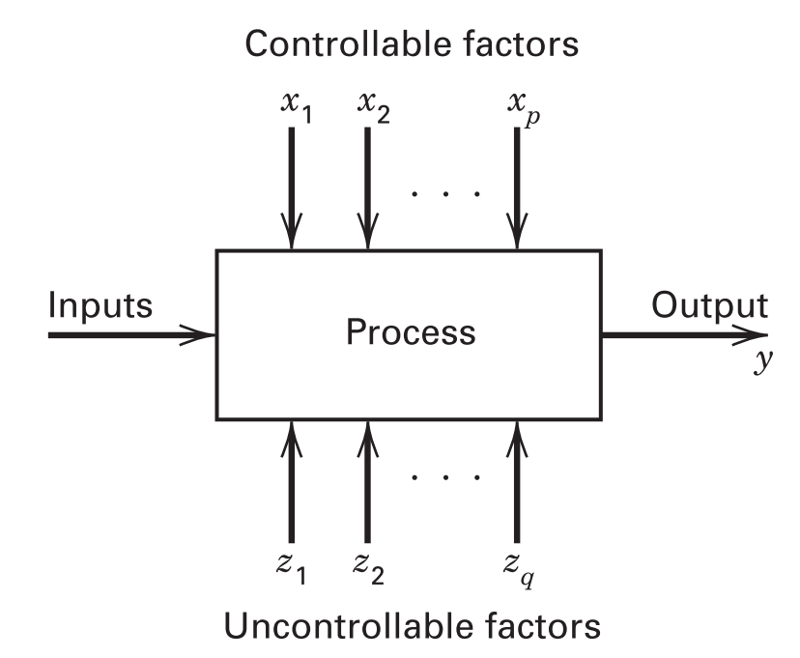
Examples: Quantitative Tool 2
Tool 2: Design of Experiments
Input → ‘factors’ (X) Output → ‘responses’ (Y)
Y = f(x)
Why Experiment?
To understand cause-and-effect relationships in a process you must deliberately change the input variables to the process and observe the changes in the process output that these changes to the inputs produce.

Slide 16
Example: Qualitative Tools – 1 (Affinity Diagram)
Problem: Defective Incoming Materials
Supplier Provided Poor Quality of Materials
Ambiguous Specifications
Poor Performing Equipment
Policy not Clear
No Contract Review
Lack of Skills of Employees (Supplier)
Not Systematic
Lack of Skills of Employees
(Purchasing Dept.)
Material Specifications
Supplier Commitment
Unsystematic Purchase Department
Ambiguous Specifications
Lack of Skills of Employees (Supplier)
Lack of Skills of Employees
(Purchasing Dept.)
No Contract Review
Supplier provided Poor Quality of Materials
Policy not Clear
Poor Performing Equipment
Not Systematic

Slide 17
Example: Qualitative Tools – (2)
Tool 2: Project Prioritization Matrix
Project Prioritization Matrix
Project Number |  | 1 | 2 | 3 | 4
Potential Projects |  | Project A | Project B | Project C | Project D
Project Characteristic (Y) | Priority 1-10 | X Correlation with Y (1 = weak, 3 = moderate, 9 = strong)
1. Is it likely that the project can be completed within six months? | 7 | 3 | 3 | 1 | 3
2. Does the project represent a significant improvement in quality? | 10 | 3 | 3 | 9 | 3
3. Will $100k saving will take place? | 8 | 9 | 3 | 3 | 1
Total |  | 123 | 75 | 121 | 59

Slide 18
Integrating Qualitative & Quantitative Tools with DMAIC Methodology
Define
Measure
Analyze
Improve
Control
Problem Statement & Scope
(Factual)
Map ‘as is’ value stream
Identify potential causes (Xs)
Brainstorm possible solutions
Establish control plan measures
Project Objectives & benefits
Collect & validate measurement system data
Filter causes significance
Identify best solution and implement pilot plan
Finalize transitions
Project Charter/Project Storyboard
Quantify process performance/metrics
Identify significant causes impacting: Y = f(x)
Implement the plan and gauge results
Monitor the sustainability.
✓
✓
✓
✓
✓

Slide 19
Contd. .
6. Generating Short-Term Wins
Reward the short term wins to establish culture of problemm solving
7. SUSTAIN ACCELERATION
Involve cross functional collaboration in the problem solving with designated KPIS
8. INSTITUTE CHANGE
Establish Strategical Projects Monitoring Committee and set accountability measures in place

Slide 20
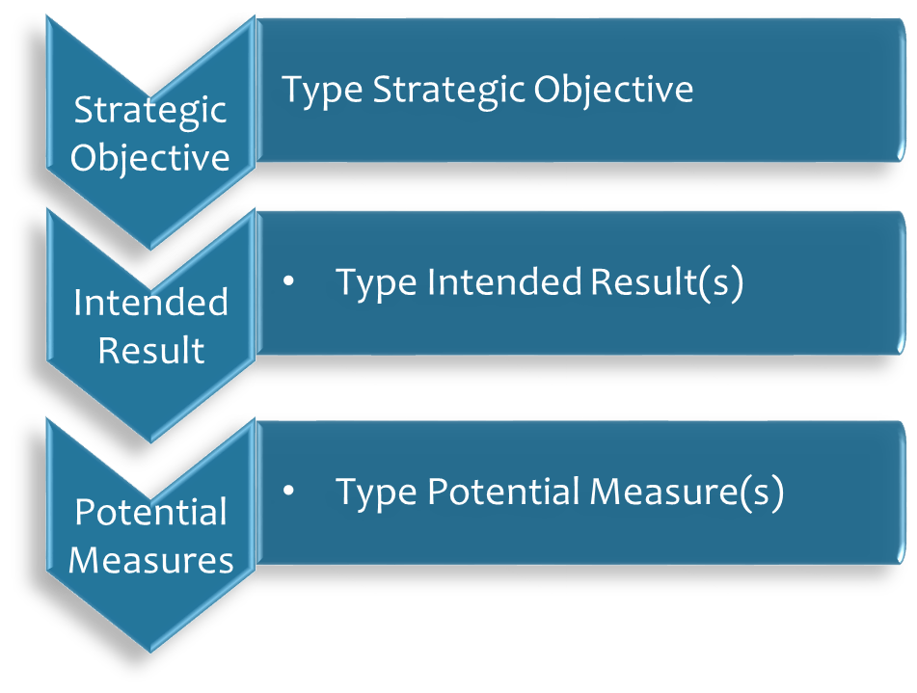
In a summary. .

Slide 21
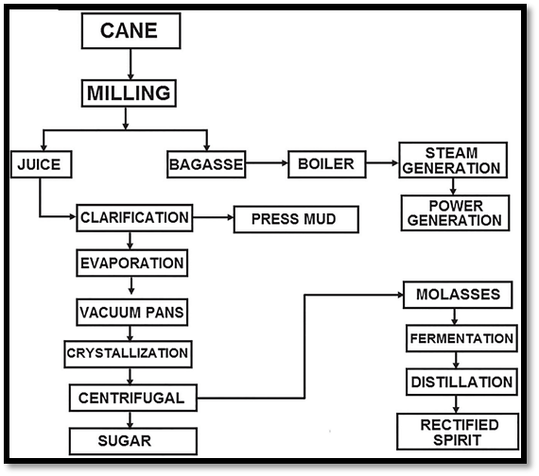
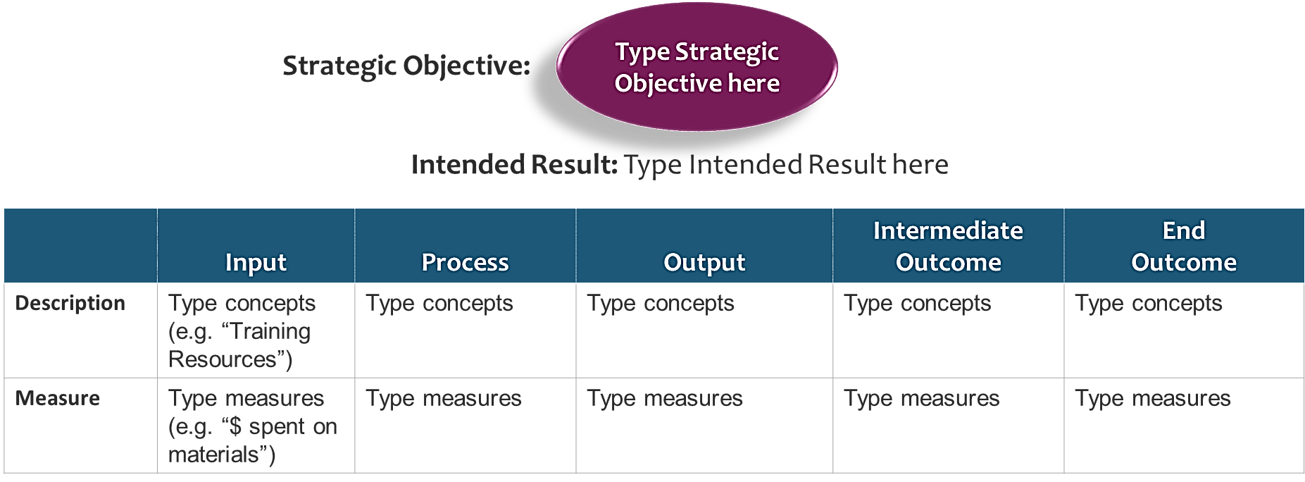
Integrating Sugar Industry Value Chain With IPO Model

Slide 22
Key Takeaway: Why embrace Change?

